Slide 1
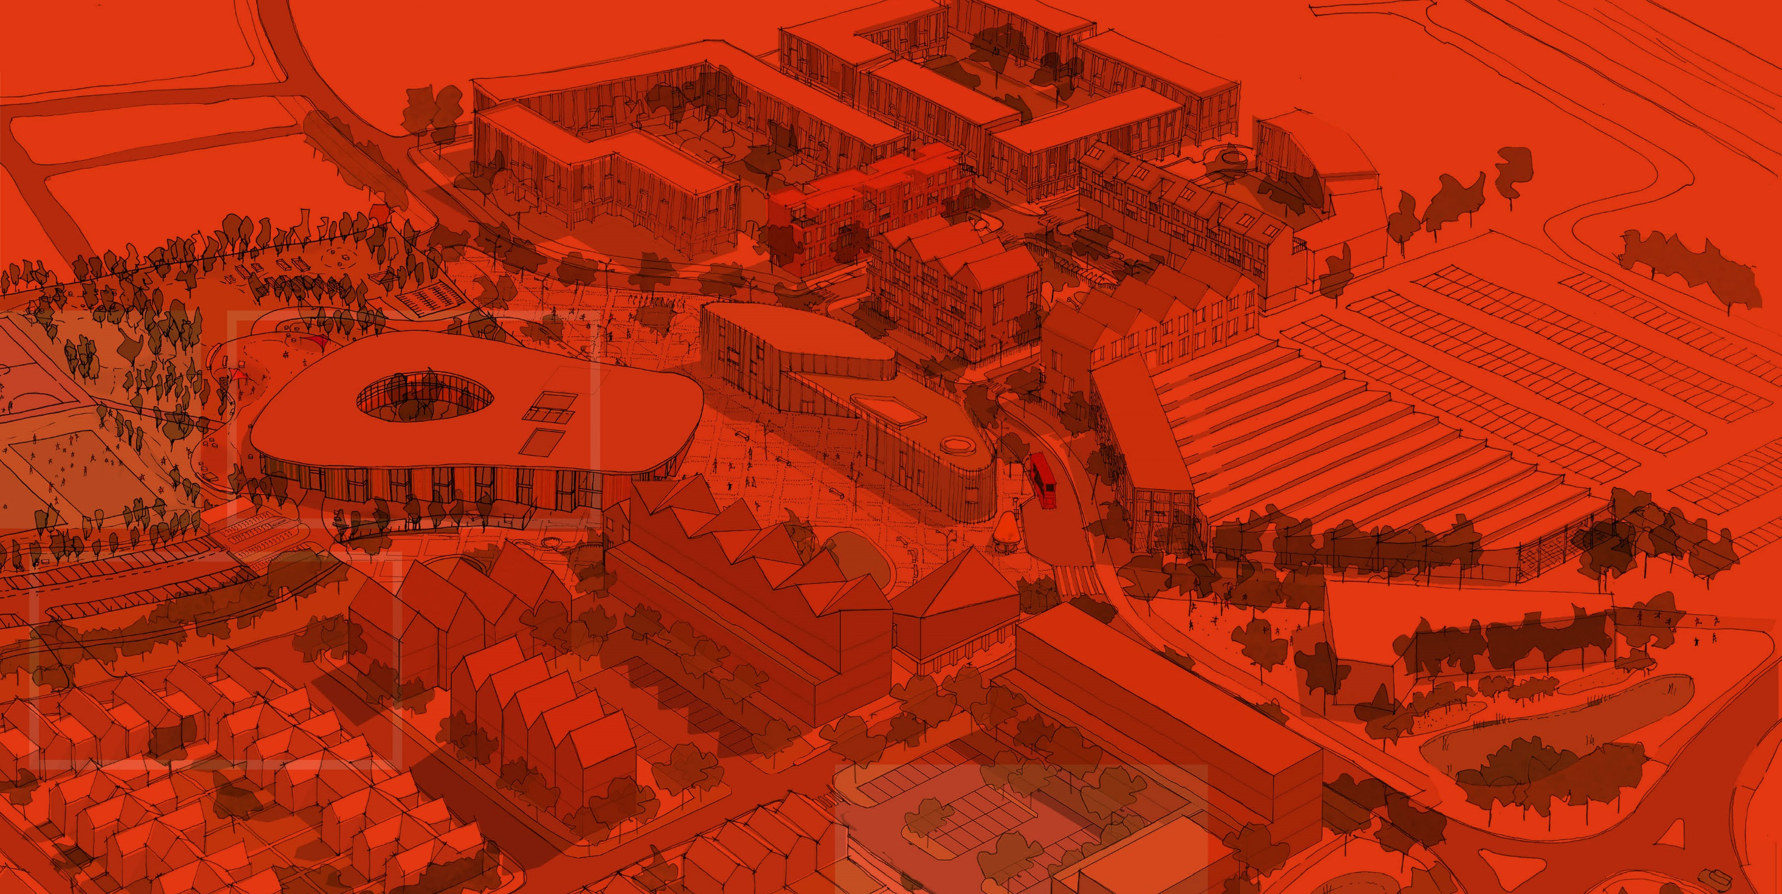






Wintringham Primary Academy

Slide 2
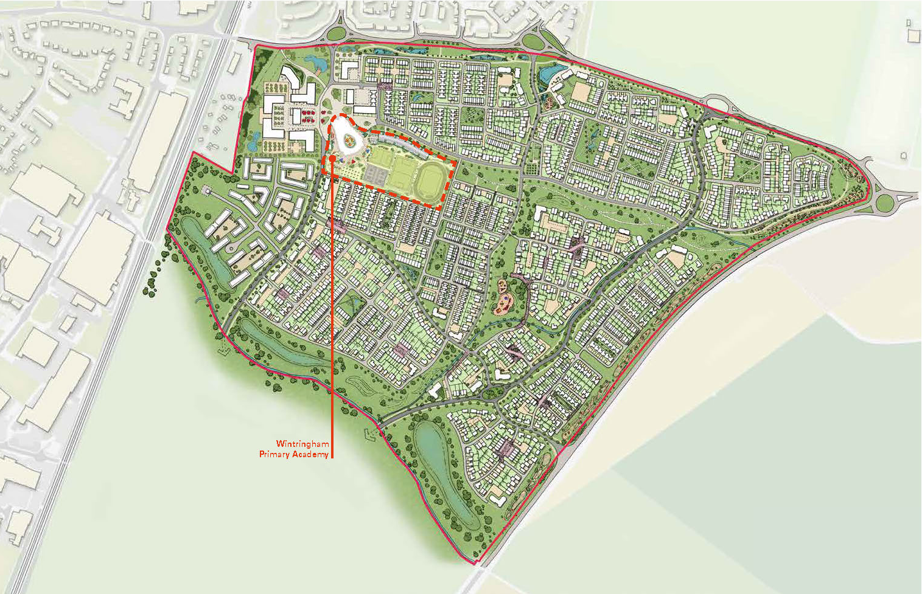

Slide 3
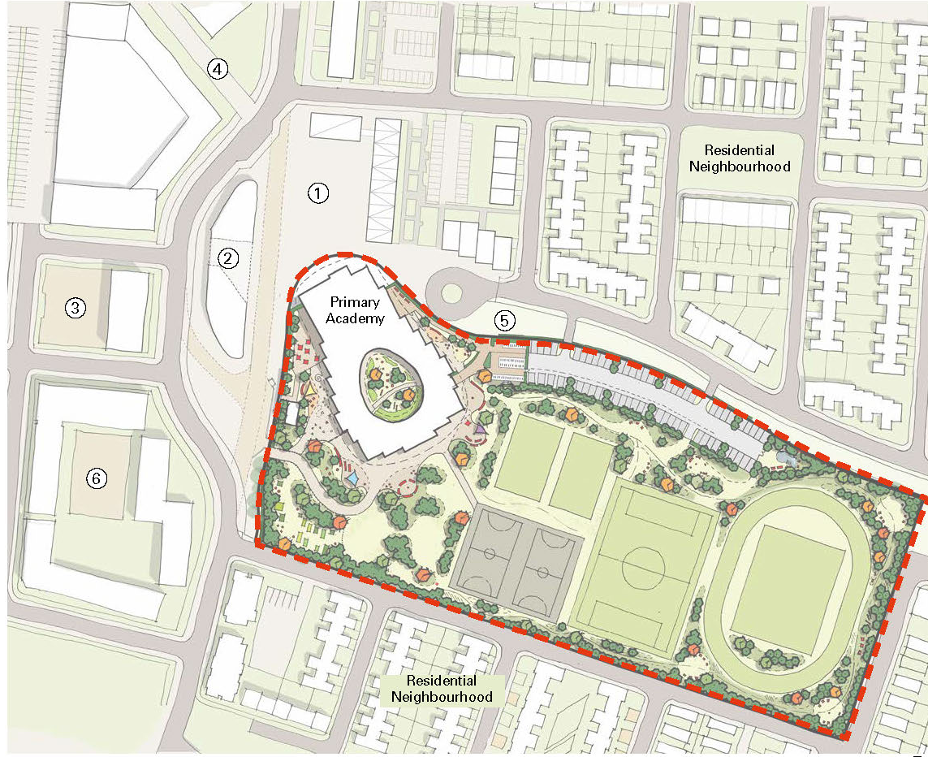
Local context
1 Market square
2 Civic Building
3 Residential Square
4 Pedestrian route to St Neots
5 Green cycle – Pedestrian Route
6 Workplace area

Slide 4
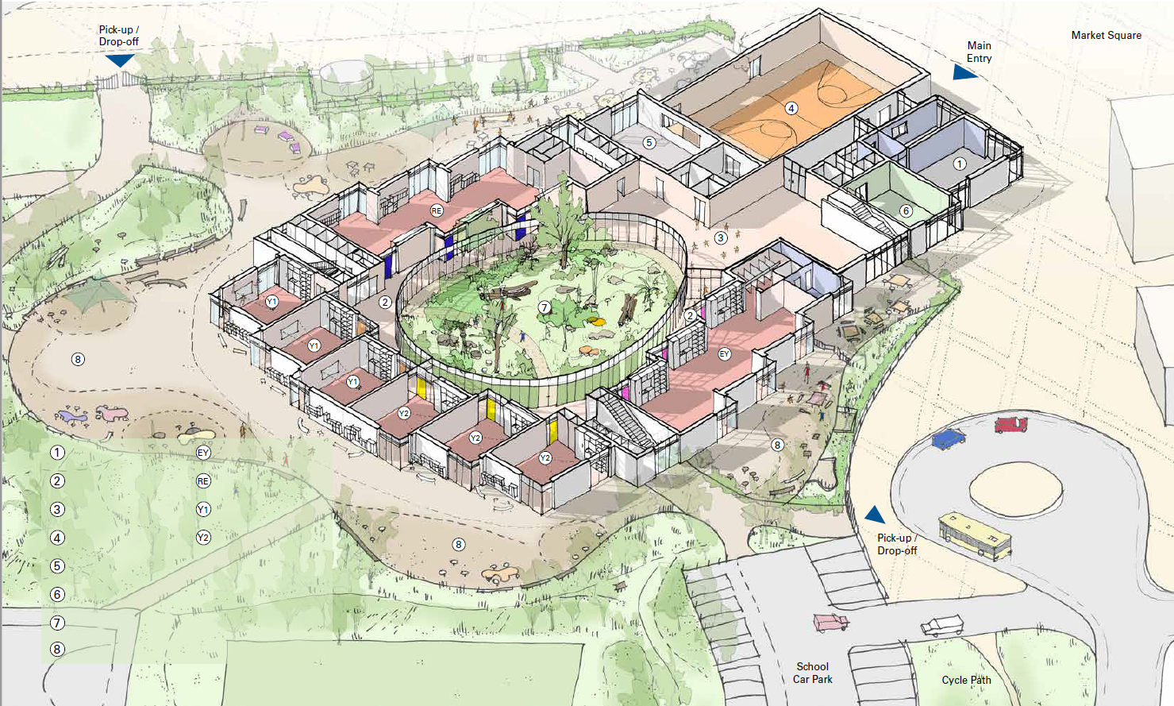
Staff room
Early Years Cluster
Circulation zone
Reception Year Cluster
ICT
Year 1 Class
School hall
Year 2 Class
Kitchen
Dance studio
Grove area
Outside teaching area
Local context

Slide 5
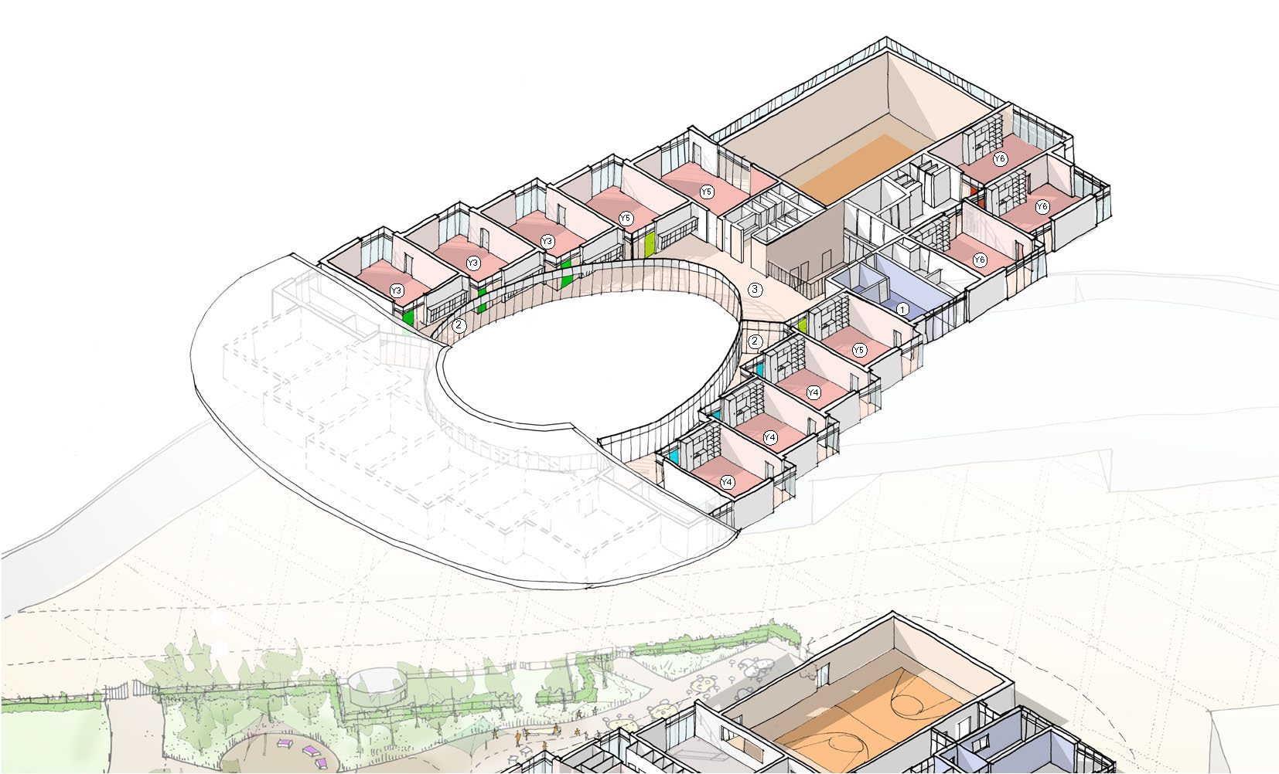
First floor plan
Staff room
Circulation
Library area
Year 3 Classroom
Year 4 Classroom
Year 5 Clasroom
Year 6 Cluster
1
3
2
Y3
Y4
Y5
Y6

Slide 6
Front entrance approach

Slide 7
Front entrance approach

Slide 8
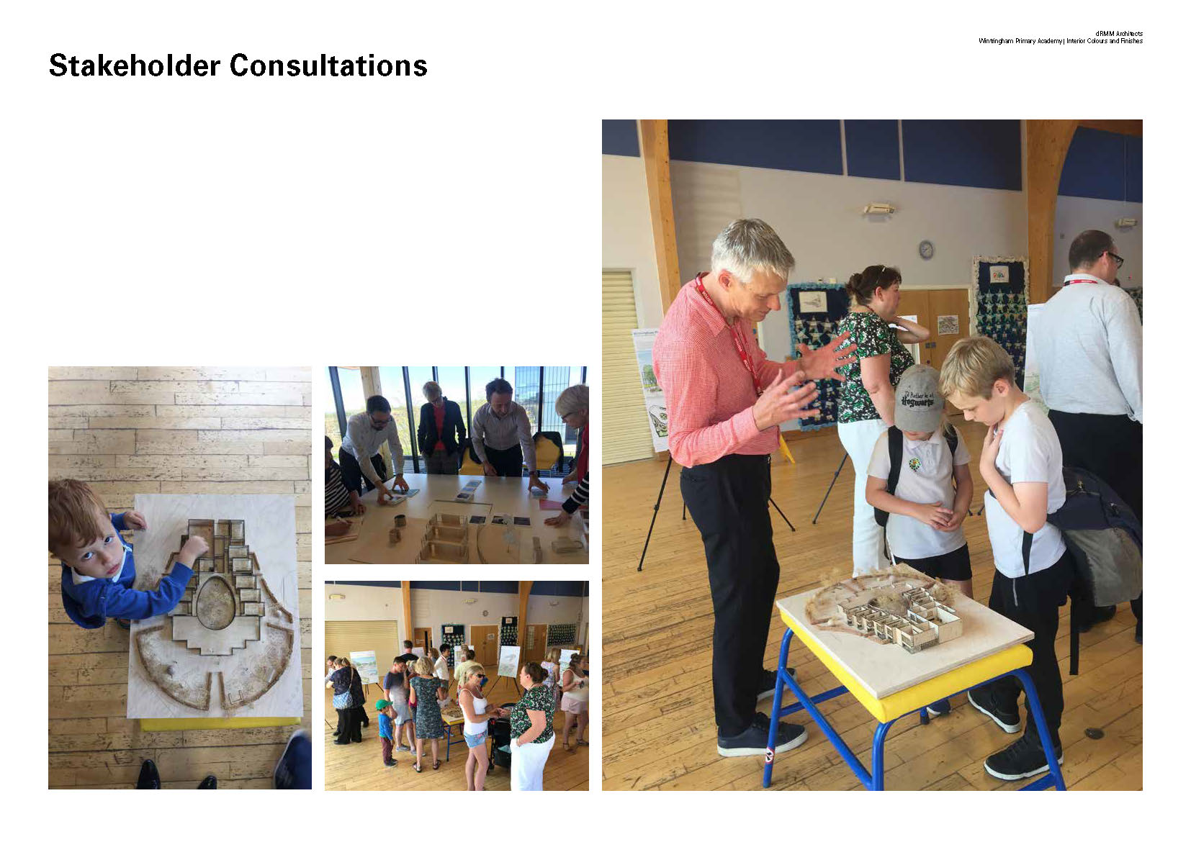
Stakeholder consultations

Slide 9
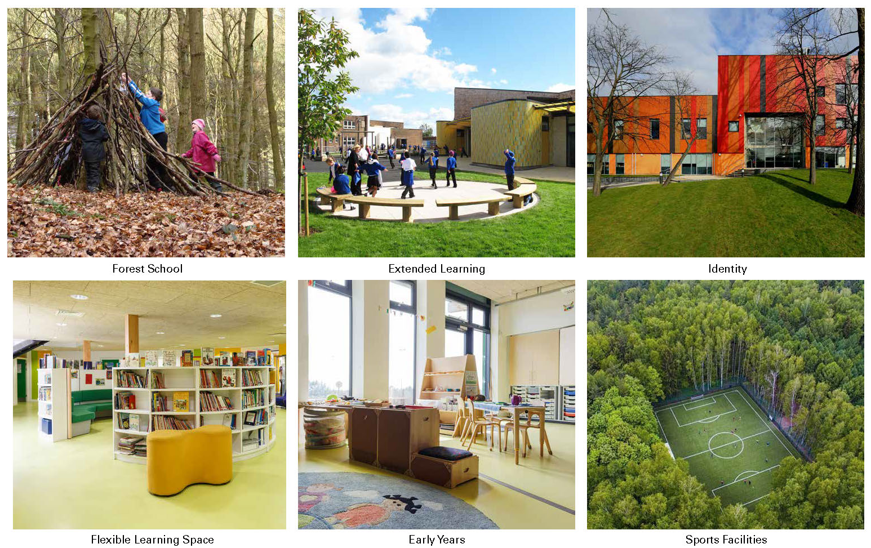
Aspirations

Slide 10
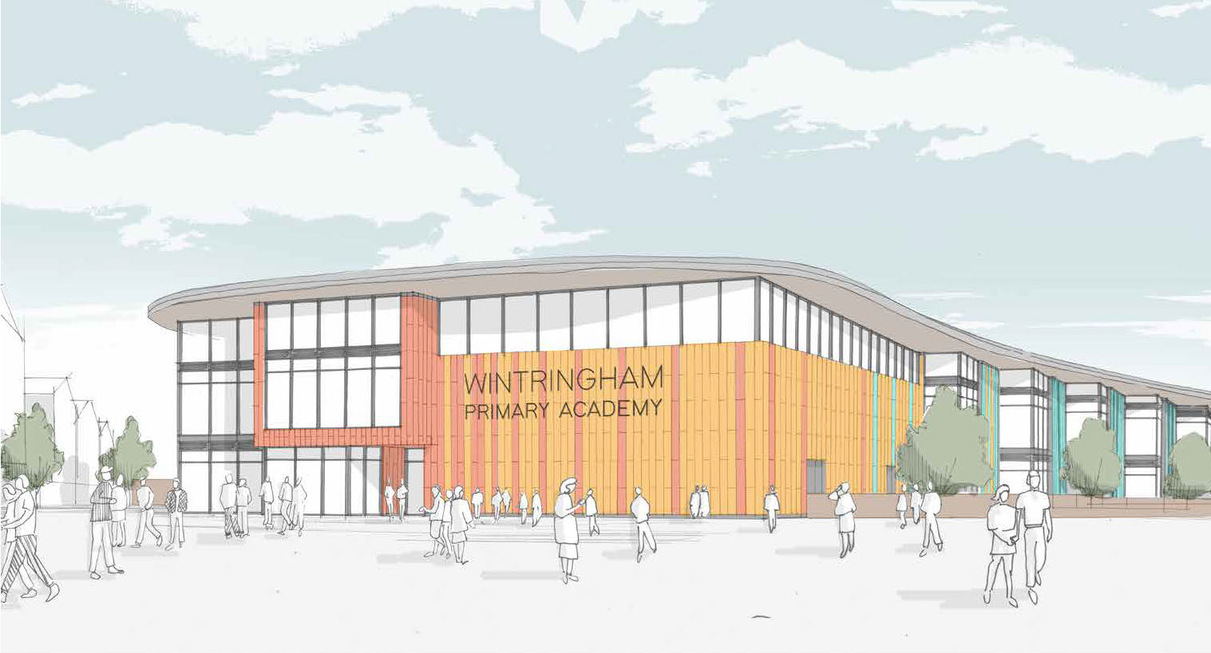
School Plaza (subject to planning)

Slide 11
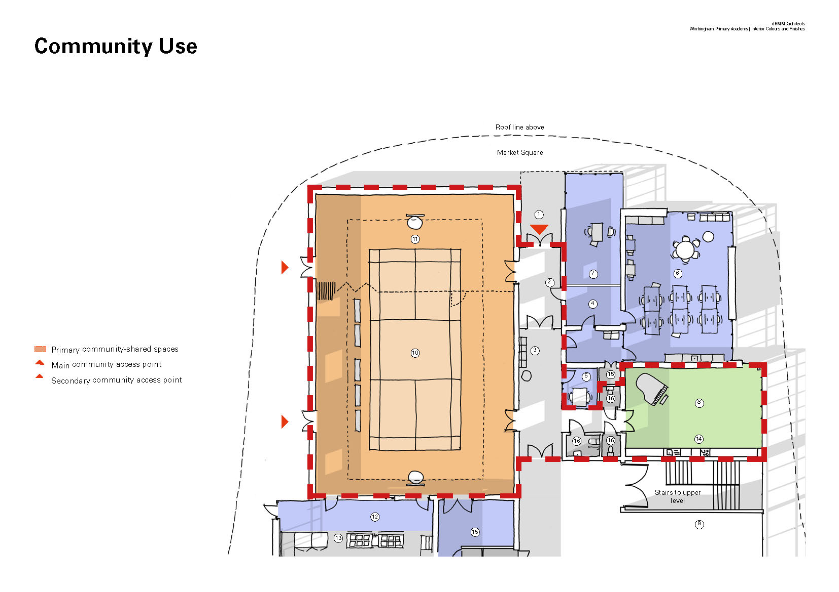
Community use
1
3
5
Main entrance
Reception
Circulation
Sick bay
Staff Work room
Staff office
General office
Studio/Food/DT
Small Group Area
Main Hall
11
Small hall
Kitchen
School kitchen
P E Store
2
12
13
4
15
6
7
8
9
10
Primary community-shared spaces
Main community access point
Secondary community access point

Slide 12
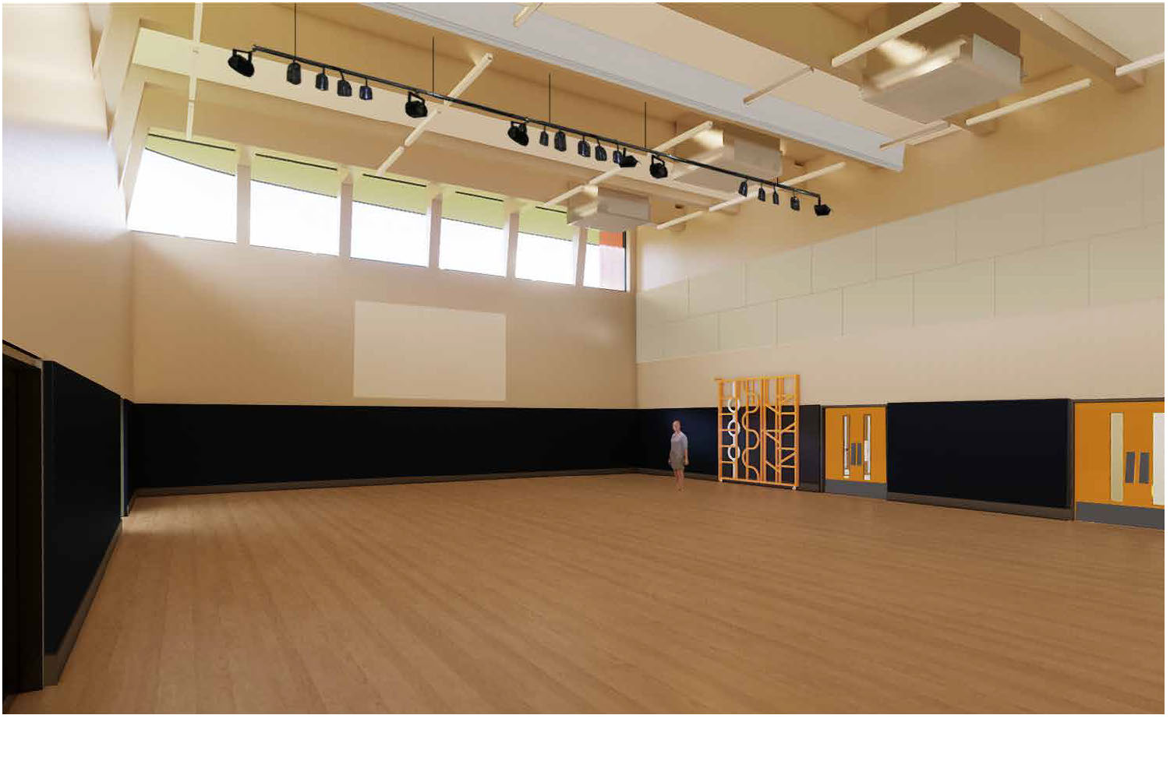
School hall

Slide 13
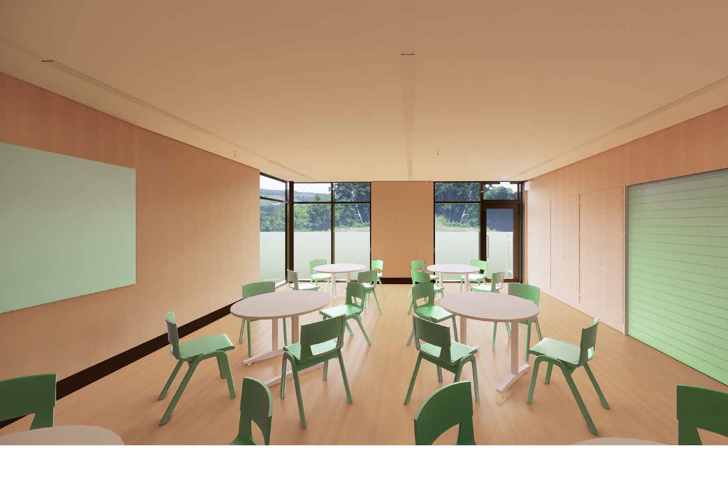
Studio / Foot Tech / Science & DT

Slide 14
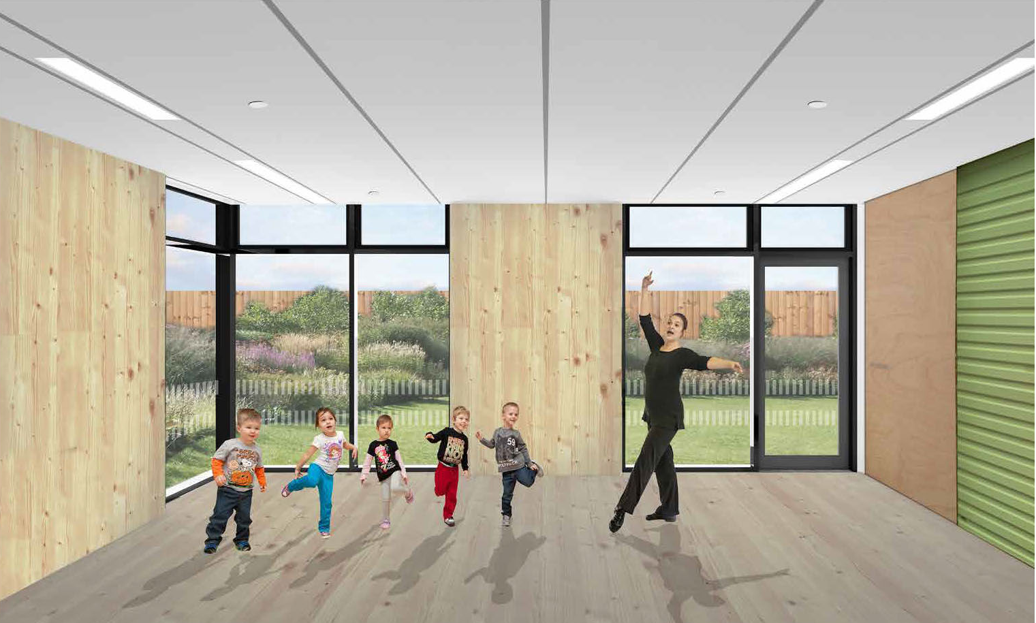
Studio / Foot Tech / Science & DT

Slide 15
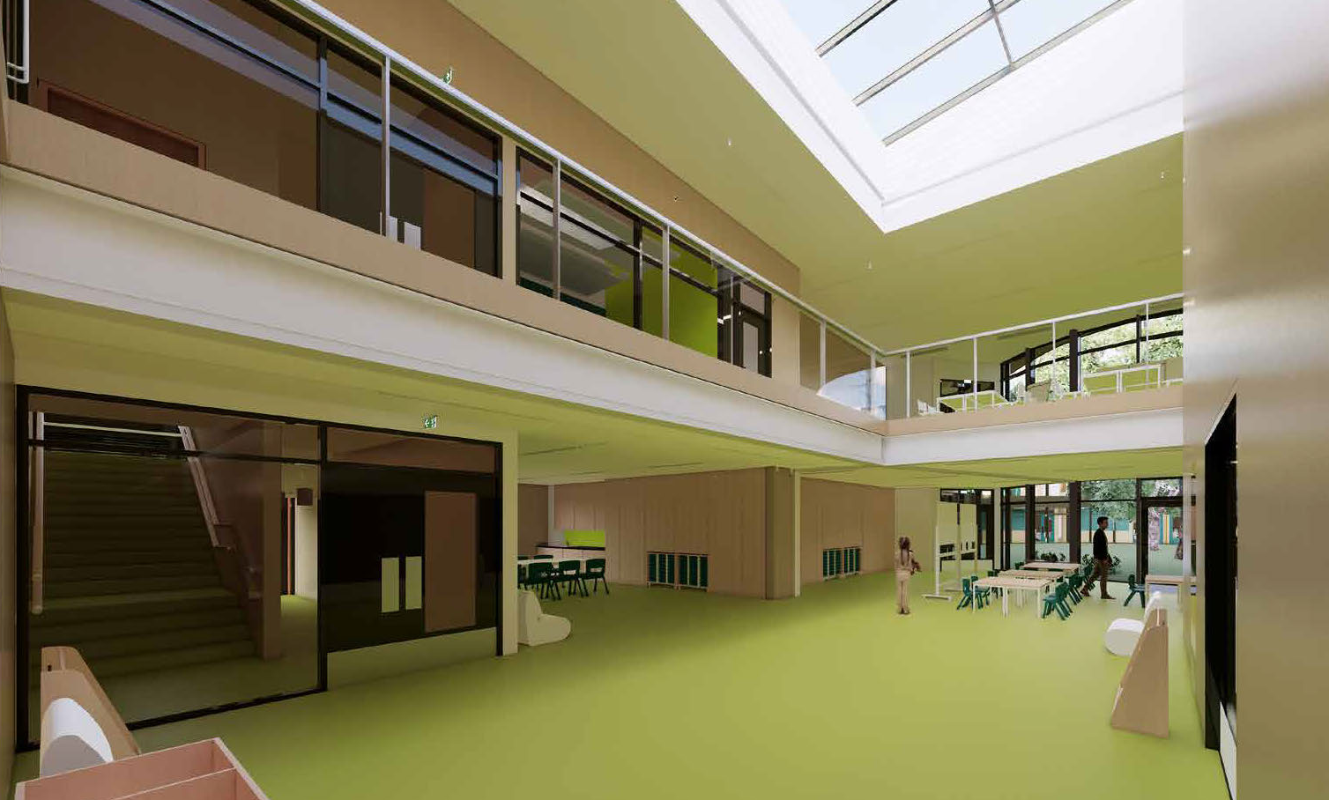
Atrium

Slide 16
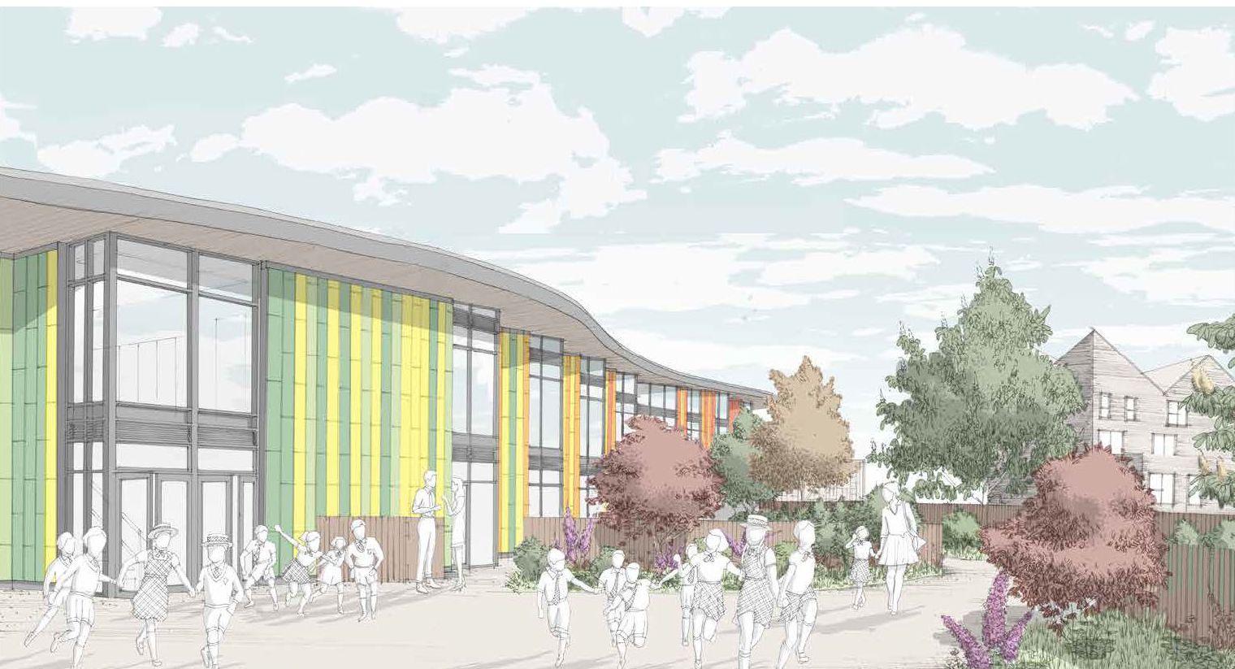
North East Entry

Slide 17
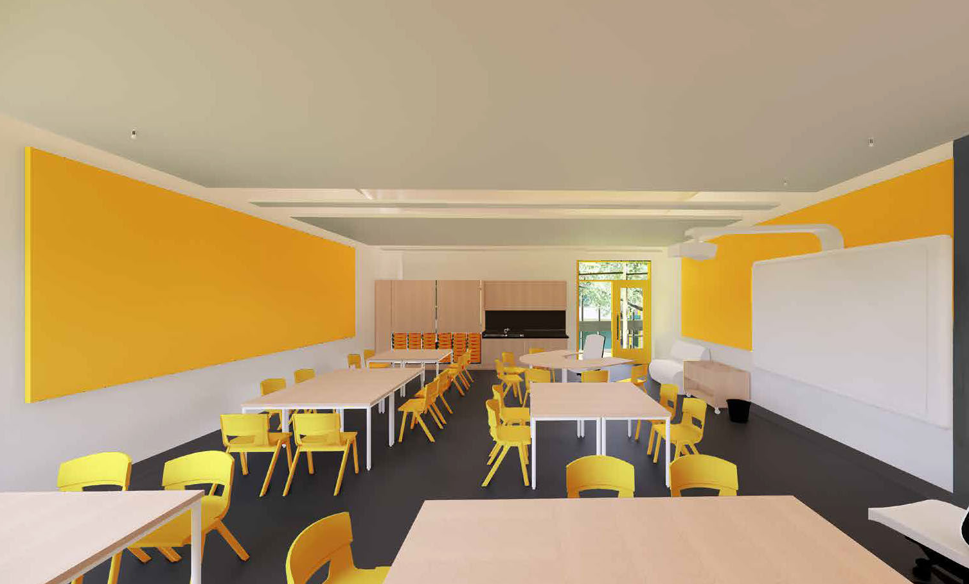
Year 1 colour scheme

Slide 18
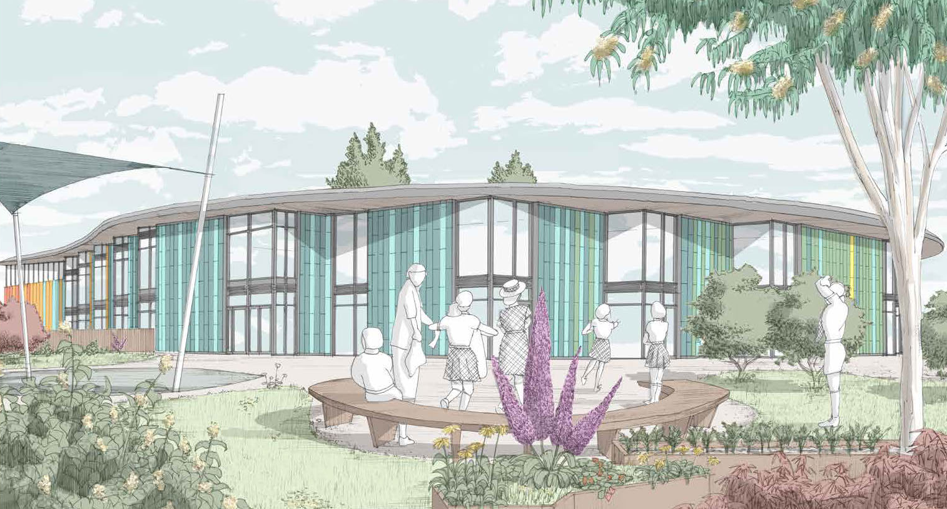
Play areas and outside
teaching areas

Slide 19
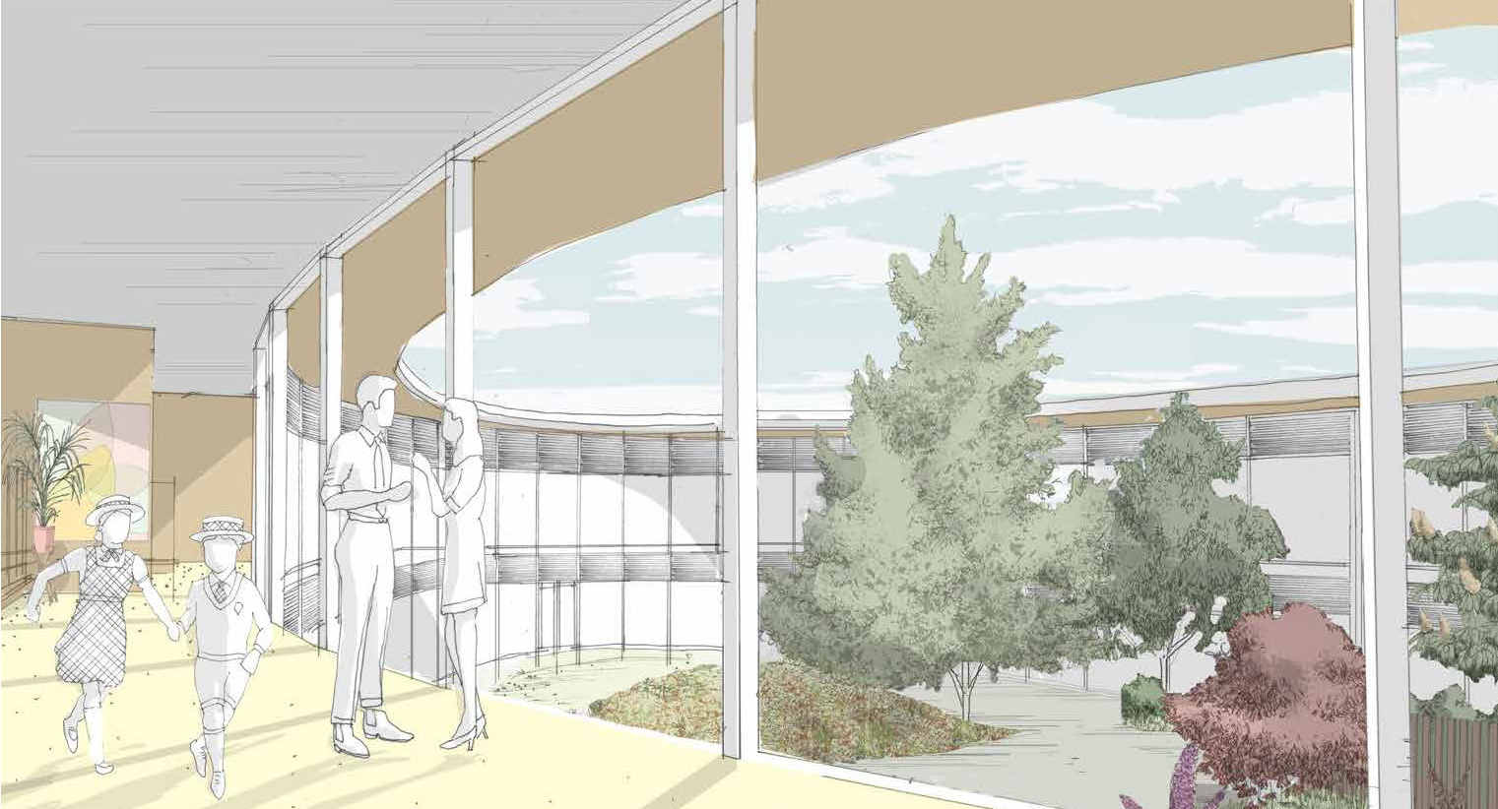
The Grove
(first floor circulation areas)

Slide 20
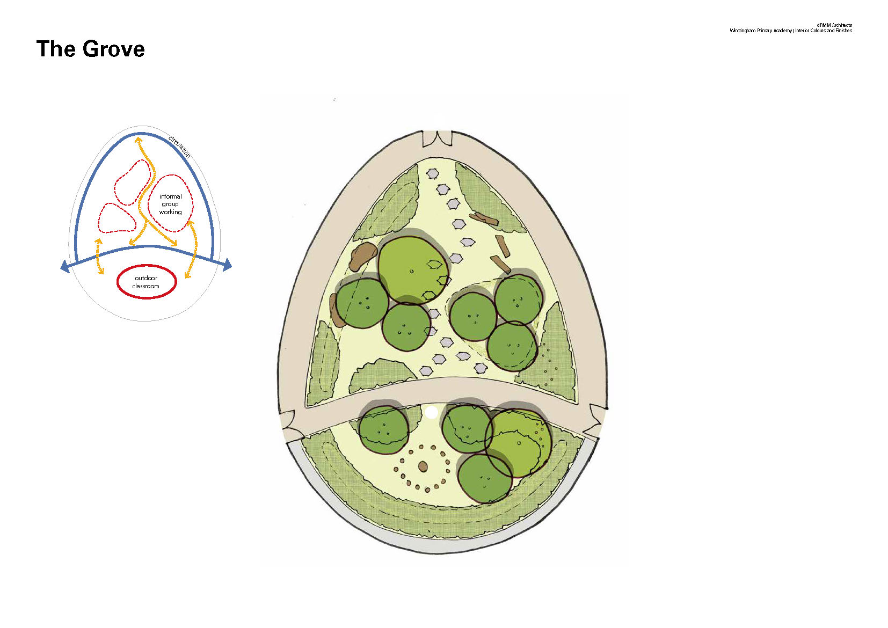
The Grove

Slide 21
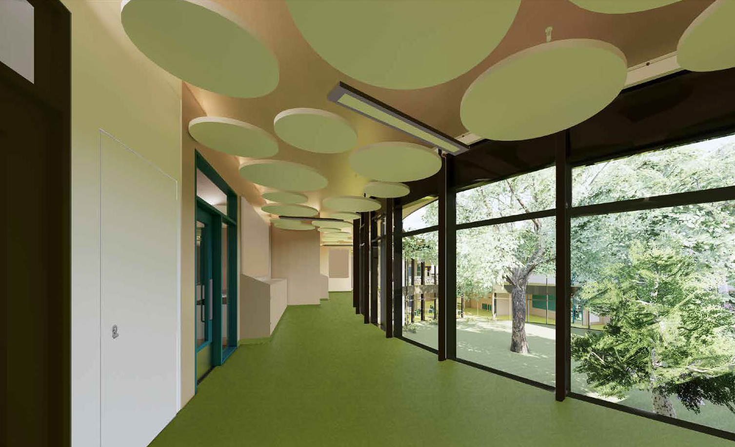
Circulation areas

Slide 22
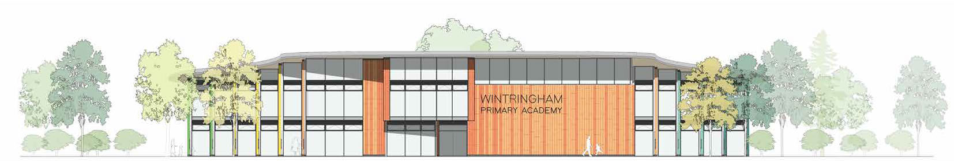
School Plaza
North elevation

Slide 23
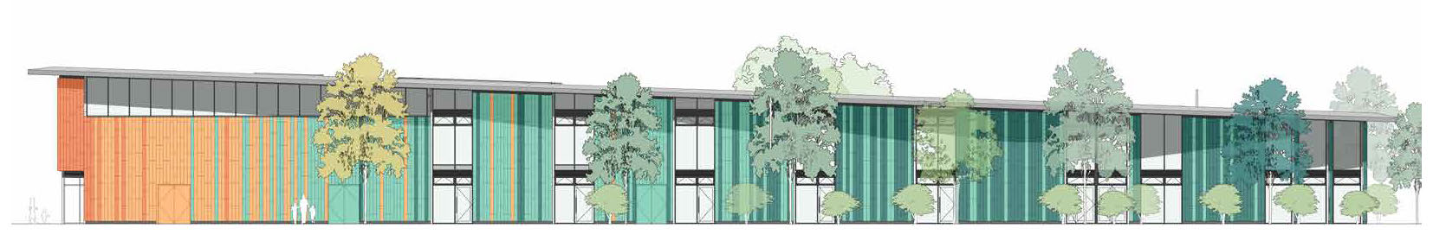
South West Elevation

Slide 24
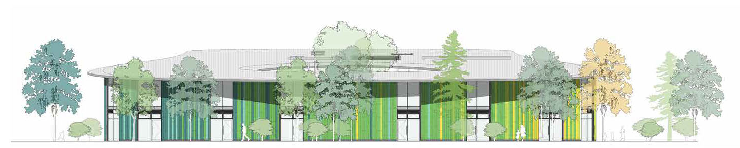
Landscape elevation
North

Slide 25
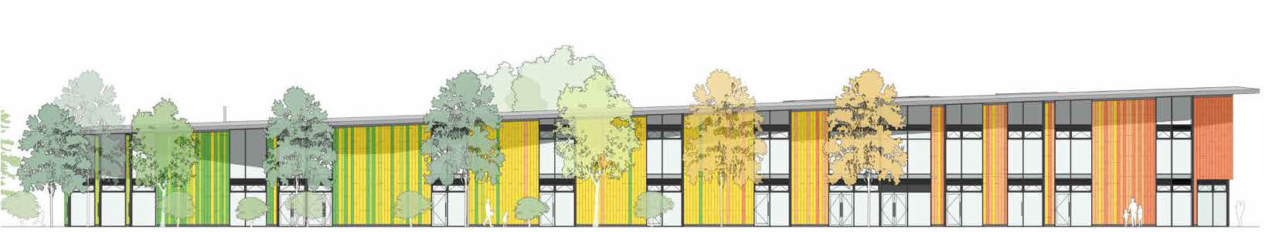
North East Elevation

Slide 26
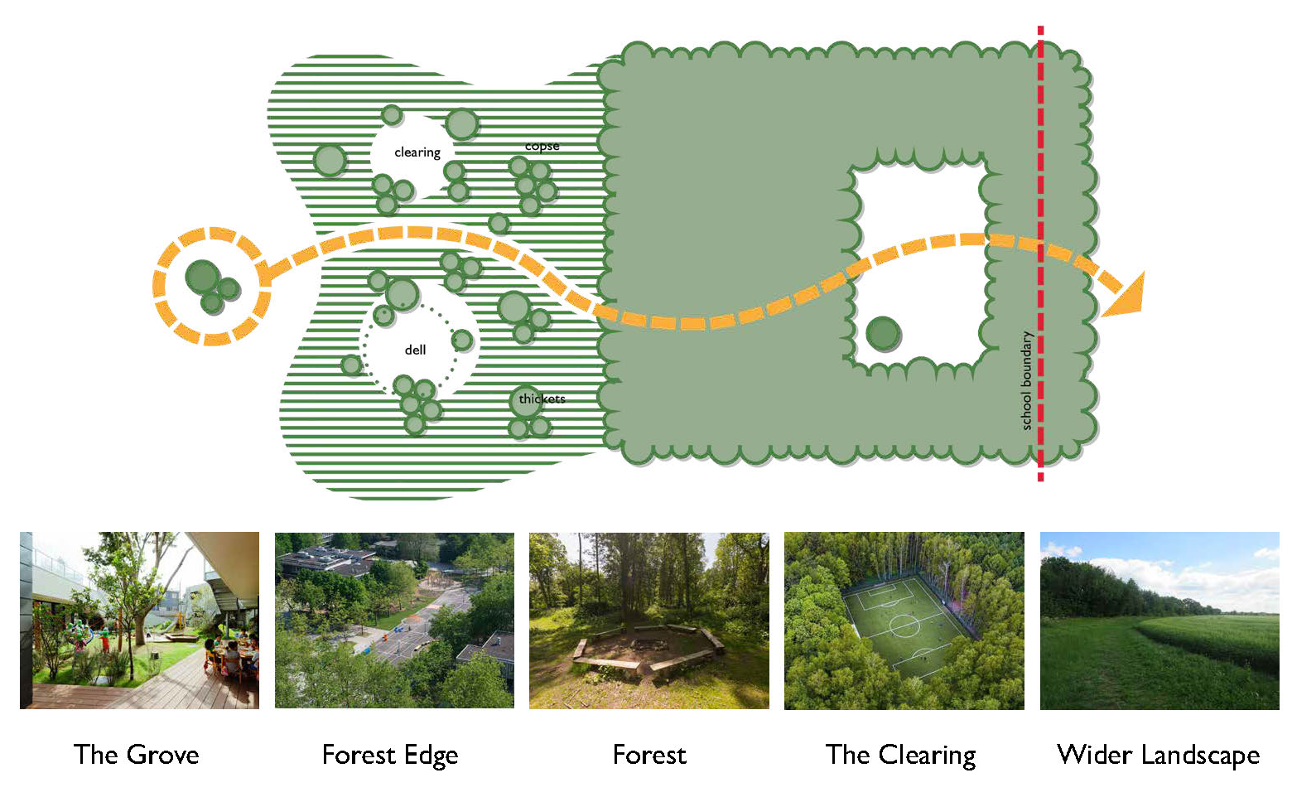
Landscape context

Slide 27
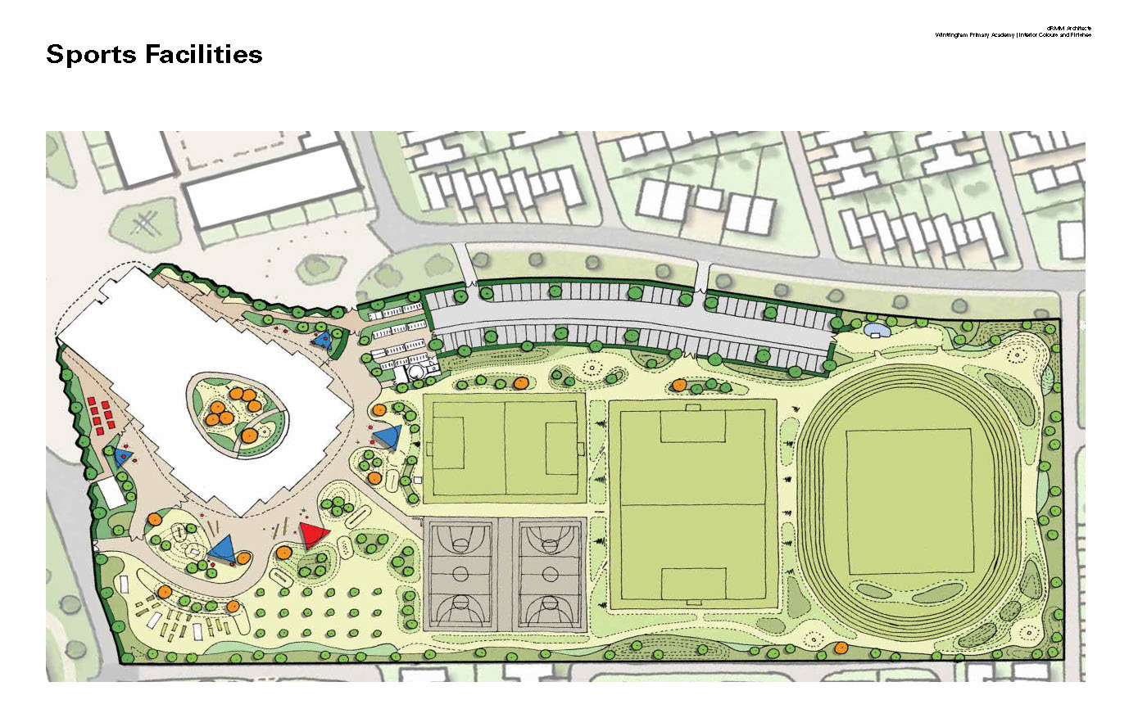
Sports facilities

Slide 28
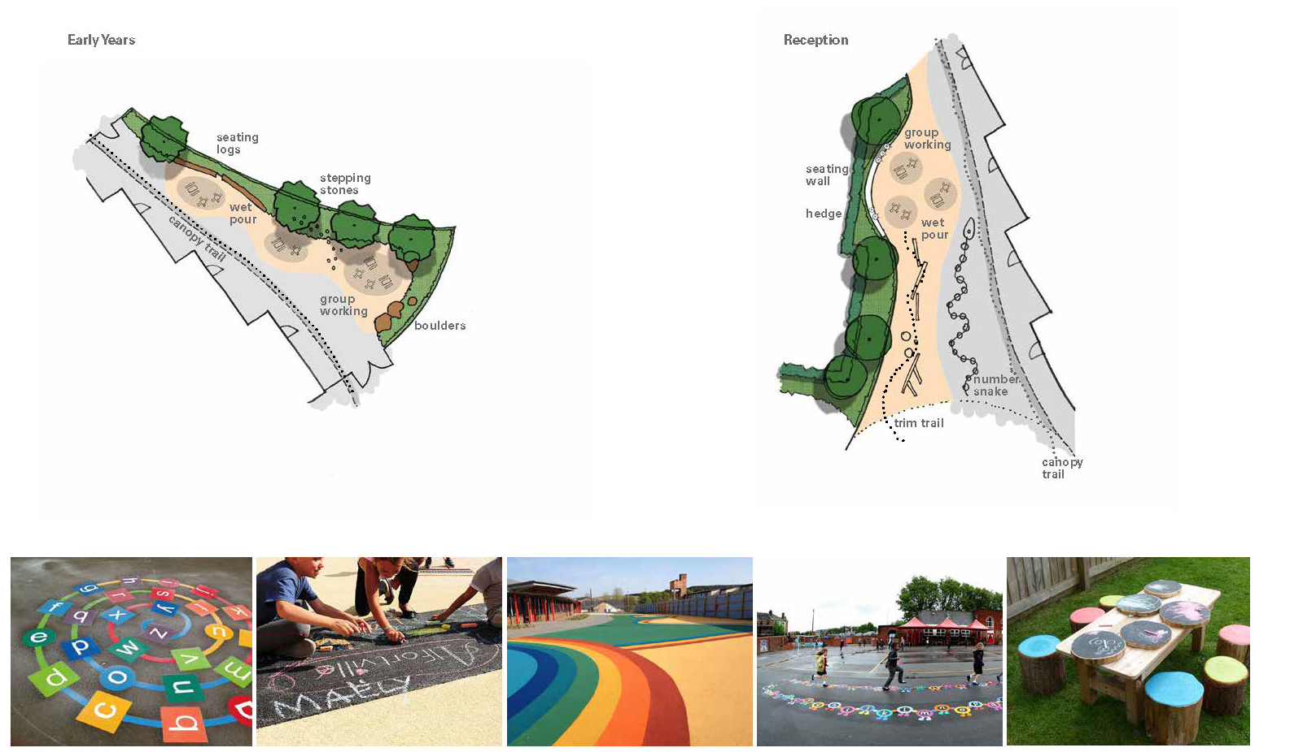
Outdoor classrooms

Slide 29
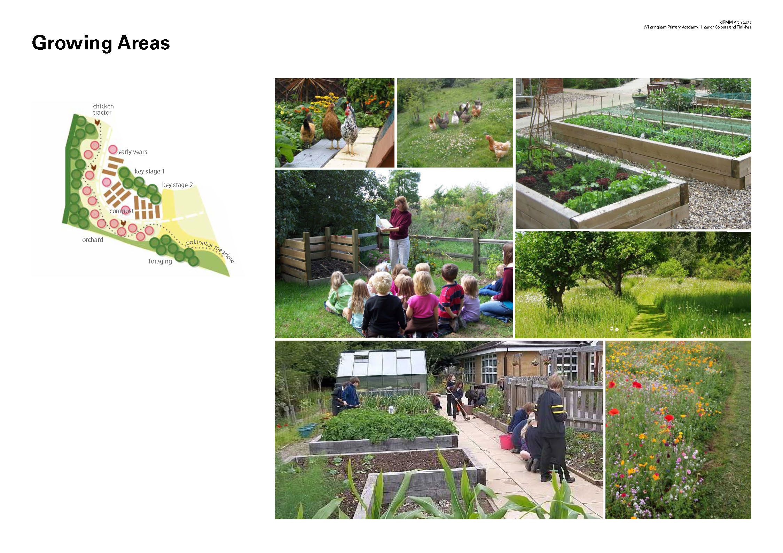
Growing areas

Slide 30
Thank you
Any questions?

