Slide 1
Early Reading and Phonics Workshop – Pre-School

Slide 2
What is Phonics?
‘Phonics refers to a method for teaching speakers of English to read and write their language’.
The National Literacy Trust.

Slide 3
Phonics
We follow the Little Wandle Phonics Scheme.
The phonics programme is divided into six phases and each phase builds upon the previous one.
In Pre-School, your child will be exploring phase one.

Slide 4
Phase One 1/ Foundations for Phonics
  Phase 1 is spilt into 7 aspects, each aspect building on the previous.
  The seven aspects are as follows:
  Aspect 1 – General sound discrimination – environmental sounds
  Aspect 2 – General sound discrimination – instrumental sounds
  Aspect 3 – General sound discrimination – body percussion
  Aspect 4 – Rhythm and rhyme
  Aspect 5 – Alliteration
  Aspect 6 – Voice sounds
  Aspect 7 – Oral blending and segmenting

Slide 5
Phase One 2
Within each aspect there are three stands:
Tuning into sounds (auditory discrimination)
Listening and remembering sounds.
Talking about sounds.

Slide 6
Aspects 1-3 General Sound Discrimination
1 – the aim of this aspect is to increase children's awareness of environmental sounds and to develop their listening and attention skills.
2 – the aim of this aspect is to increase children's awareness of the sounds made by a variety of musical instruments.
3 – the aim of this aspect is to increase children's awareness of both sounds and rhythms.

Slide 7
Aspects 4-7
4 – Rhythm and Rhyme – the aim of this aspect is to enhance the children's experiences of both rhythm and rhyme within spoken language.
5 – Alliteration – the aim of this aspect is to develop the children's awareness of alliteration, i.e. focusing on the initial sounds of words.
6 – Voice Sounds – the aim of this aspect is for the children to be able to distinguish between different sounds, as well as beginning to orally blend and segment.
7 – Oral Blending & Segmenting – the aim of this aspect is to continue to develop the children's oral blending and segmenting skills.

Slide 8
Synthetic Phonics
Teaching the letter sounds helps children to read and write.
Children are taught to segment to read, e.g. c-a-t.
If you segment then blend the sounds together they make the word ‘cat’.
If you try to blend the letter names together, it does not help you to hear the word.

Slide 9
How to Say the Sounds
Saying the sounds correctly is very important.
The way we say sounds now, may well be different from when you were at school.
We also use jolly phonics actions and songs to support the children
The link below shows you how the sounds are pronounced.
https://www.youtube.com/watch?v=-ksblMiliA8
.

Slide 10
Daily Phonics
Phonics sessions are delivered everyday for about 15 minutes.
First, we do a quick activity going over an activity covered in a previous session. This includes recapping activities in aspects already taught.
Then, the children are introduced to the new activity, based on the aspect currently being taught.
The children are then given time to put what they’ve learnt into practice.

Slide 11
Developing fine motor skills
Before your child will be able to control a pencil, they will need to develop their fine motor skills.
Fine motor skills are activities in which you use the small muscles in your hands and wrists to make precise movements.

Slide 12
Ideas for developing fine motor skills
The following activities can help your child to develop their fine motor skills:
Playdough
Creating letters in trays of sand, flour, paint, mud, etc… using their fingers
Threading activities such as beads onto string, pasta onto string etc…
Using scissors

Slide 13
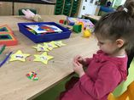
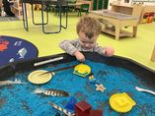
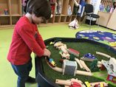
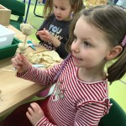
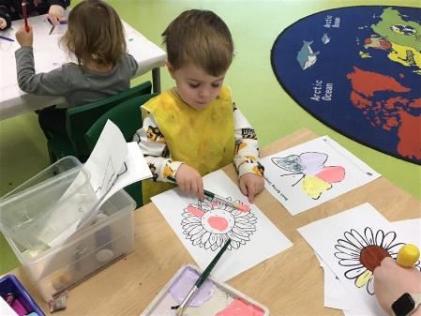
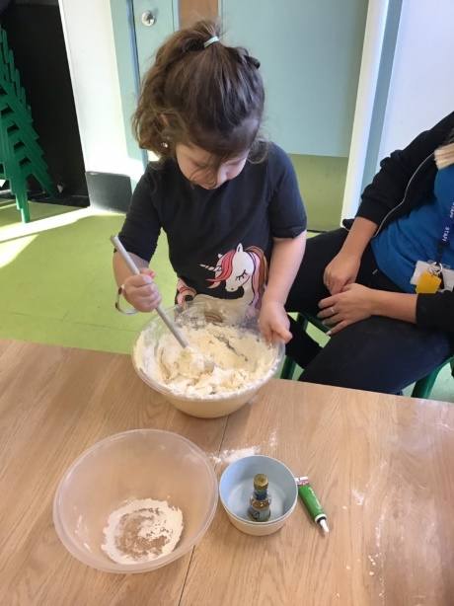
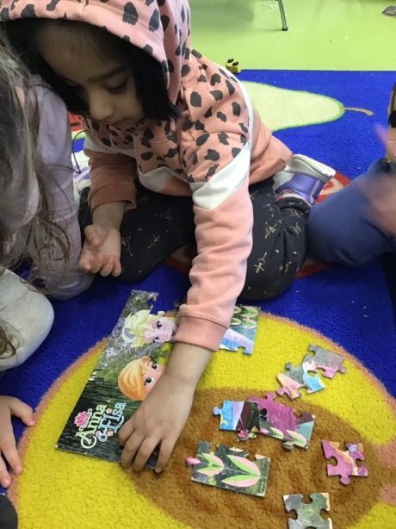
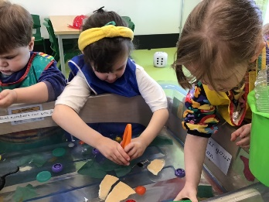
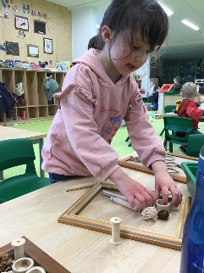
Here are few examples of children engaged in activities developing their fine motor skills.

Slide 14

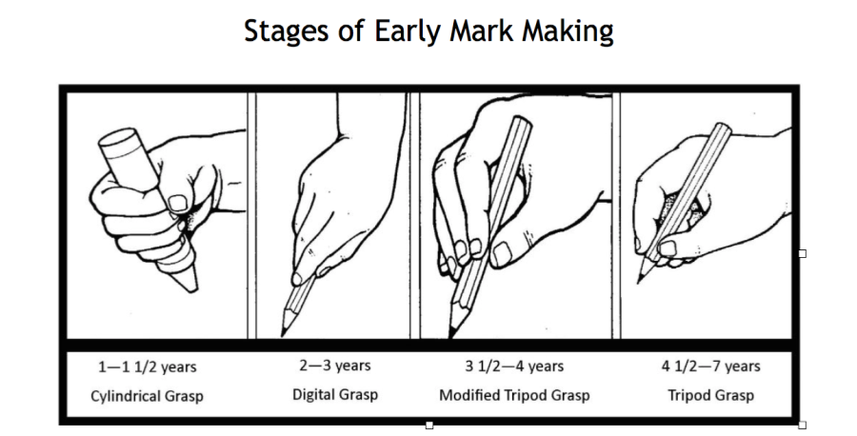
Mark Making
Before a child can write, they need to be able to mark make.
Below is a diagram to illustrate the stages that your child might go through.
It is important for children to give meaning to the marks they make.

Slide 15
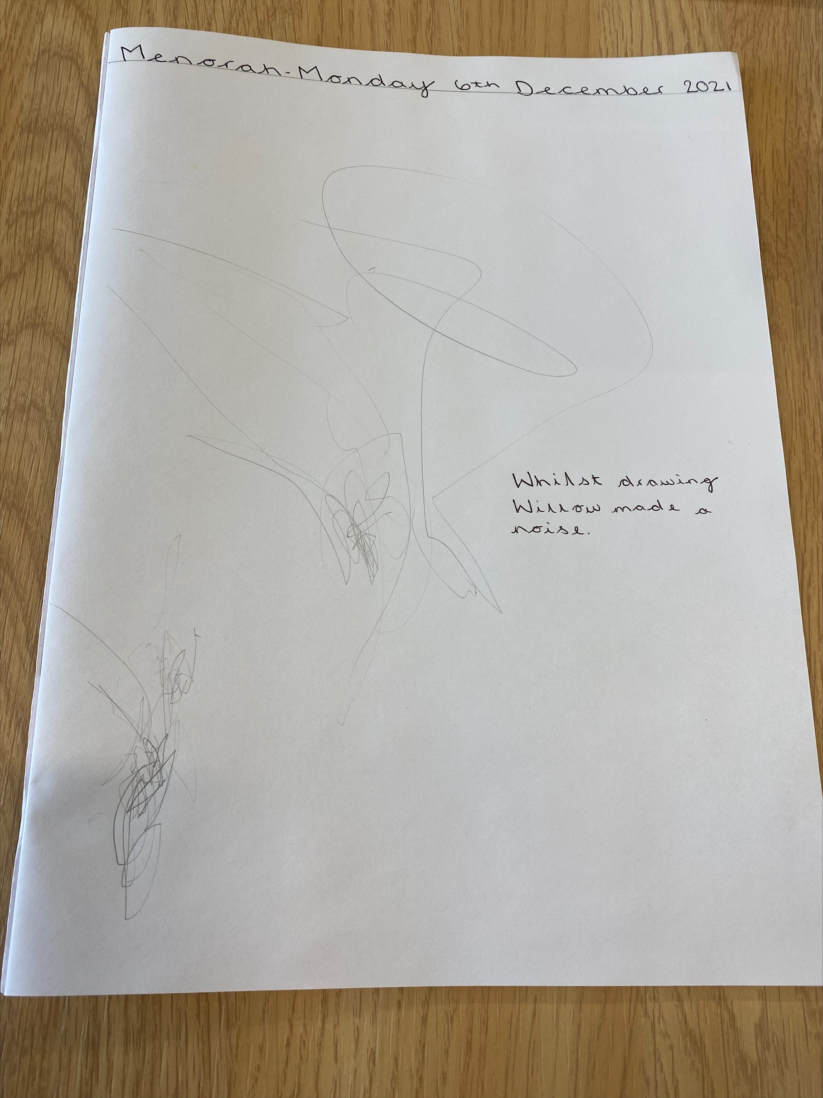
Examples of mark-making 1

Slide 16
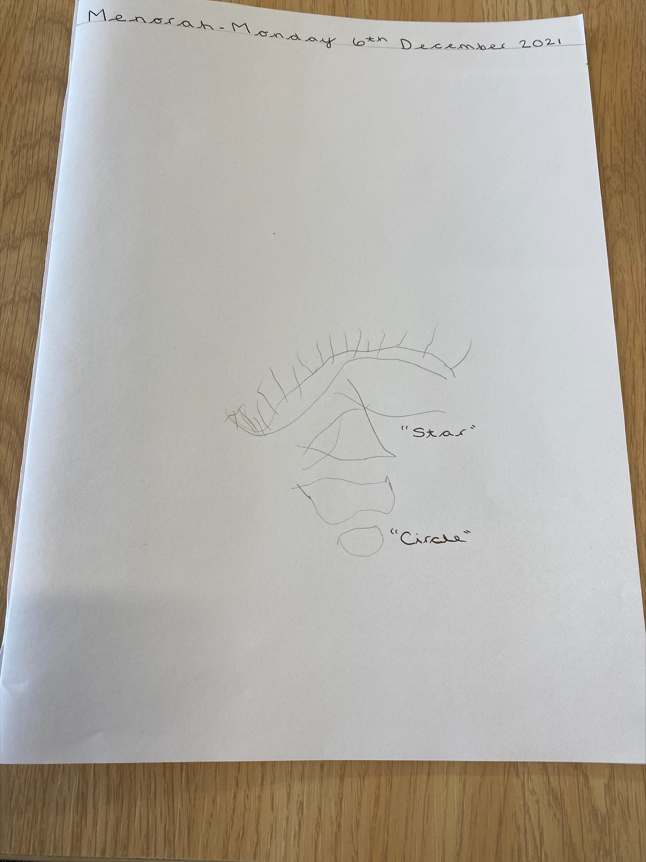
Examples of mark-making 2

Slide 17
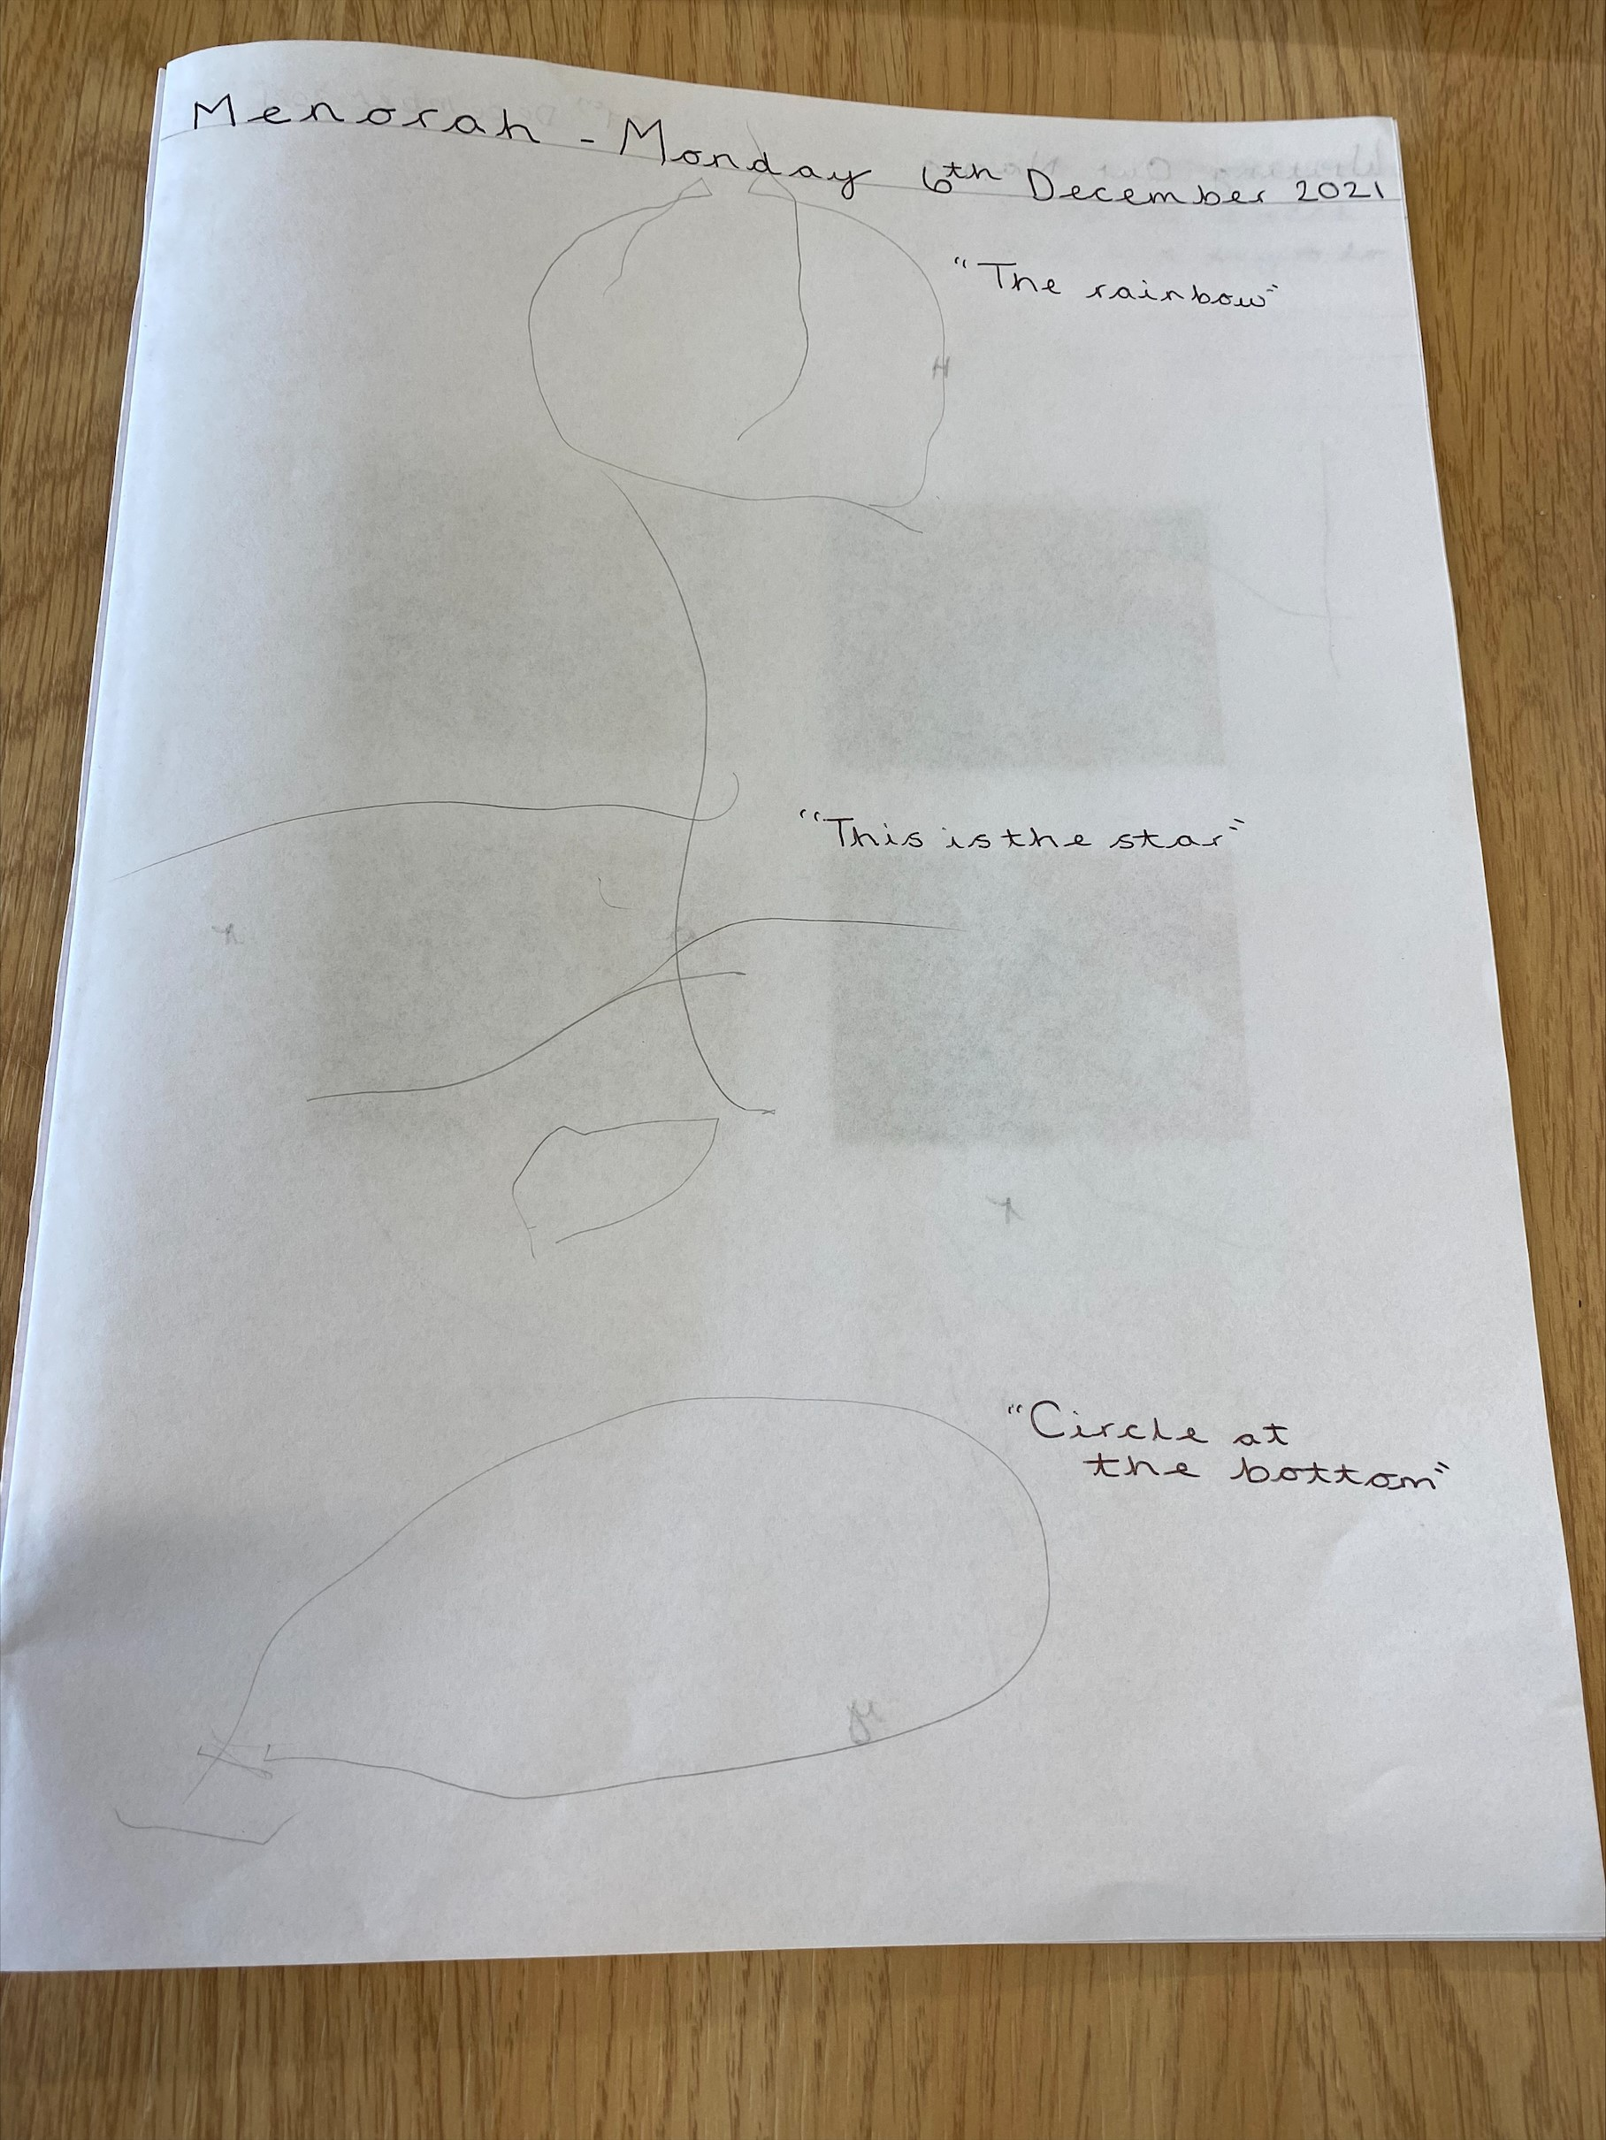
Examples of mark-making 3

Slide 18
Handwriting
Please ensure that you use lower case letters, unless it is for the capital letter at the beginning of a person’s name or at the start of a sentence.
Encourage name writing using lower case letters.
Letters need to be correctly formed.
Use a variety of media, e.g. whiteboard pens, felt tip pens, crayons, chalks, pencils and paint brushes.
For children who will be attending Roundhouse Primary Academy and Wintringham Primary Academy, we use a pre-cursive script.

Slide 19
Phase 1 – Lilac Level Books 1
Phase 1 Lilac books have great pictures, a story to discover, but no words.
These books are fabulous for:
Story telling
Looking at what is happening in each picture
Imagination and creativity
Making up story sentences
Having a lovely 10 minutes with your child

Slide 20
Phase 1 – Lilac Level Books 2
Lots of the books have ideas for parents inside the front and/or back cover, so have a quick look before you start “reading” it with your child.
As a general guide:
Tell your child the title as you point to the words on the front cover.
Look through the pictures on each page to discover what is happening.
Ask, “What is happening in the pictures?”
Sometimes ask, “What do you think could happen next?”
Chat about things that the story reminds you of e.g This reminds me of taking our dog to the vets.
Make up a story sentence for each page. Encourage your child to look at the faces of the characters to work out how they are feeling.

Slide 21
Phase 1 – Lilac Level Books 3
These books are designed to get your children interested in stories and books and it is a fun activity that you can do together.
When you have “read” the book with your child, please write the date and a comment about how your child got on.
Your child will receive a new book twice a week. A timetable for this will be put in place and shared with you. This will get them into a good routine for when they start in Reception.

Slide 22
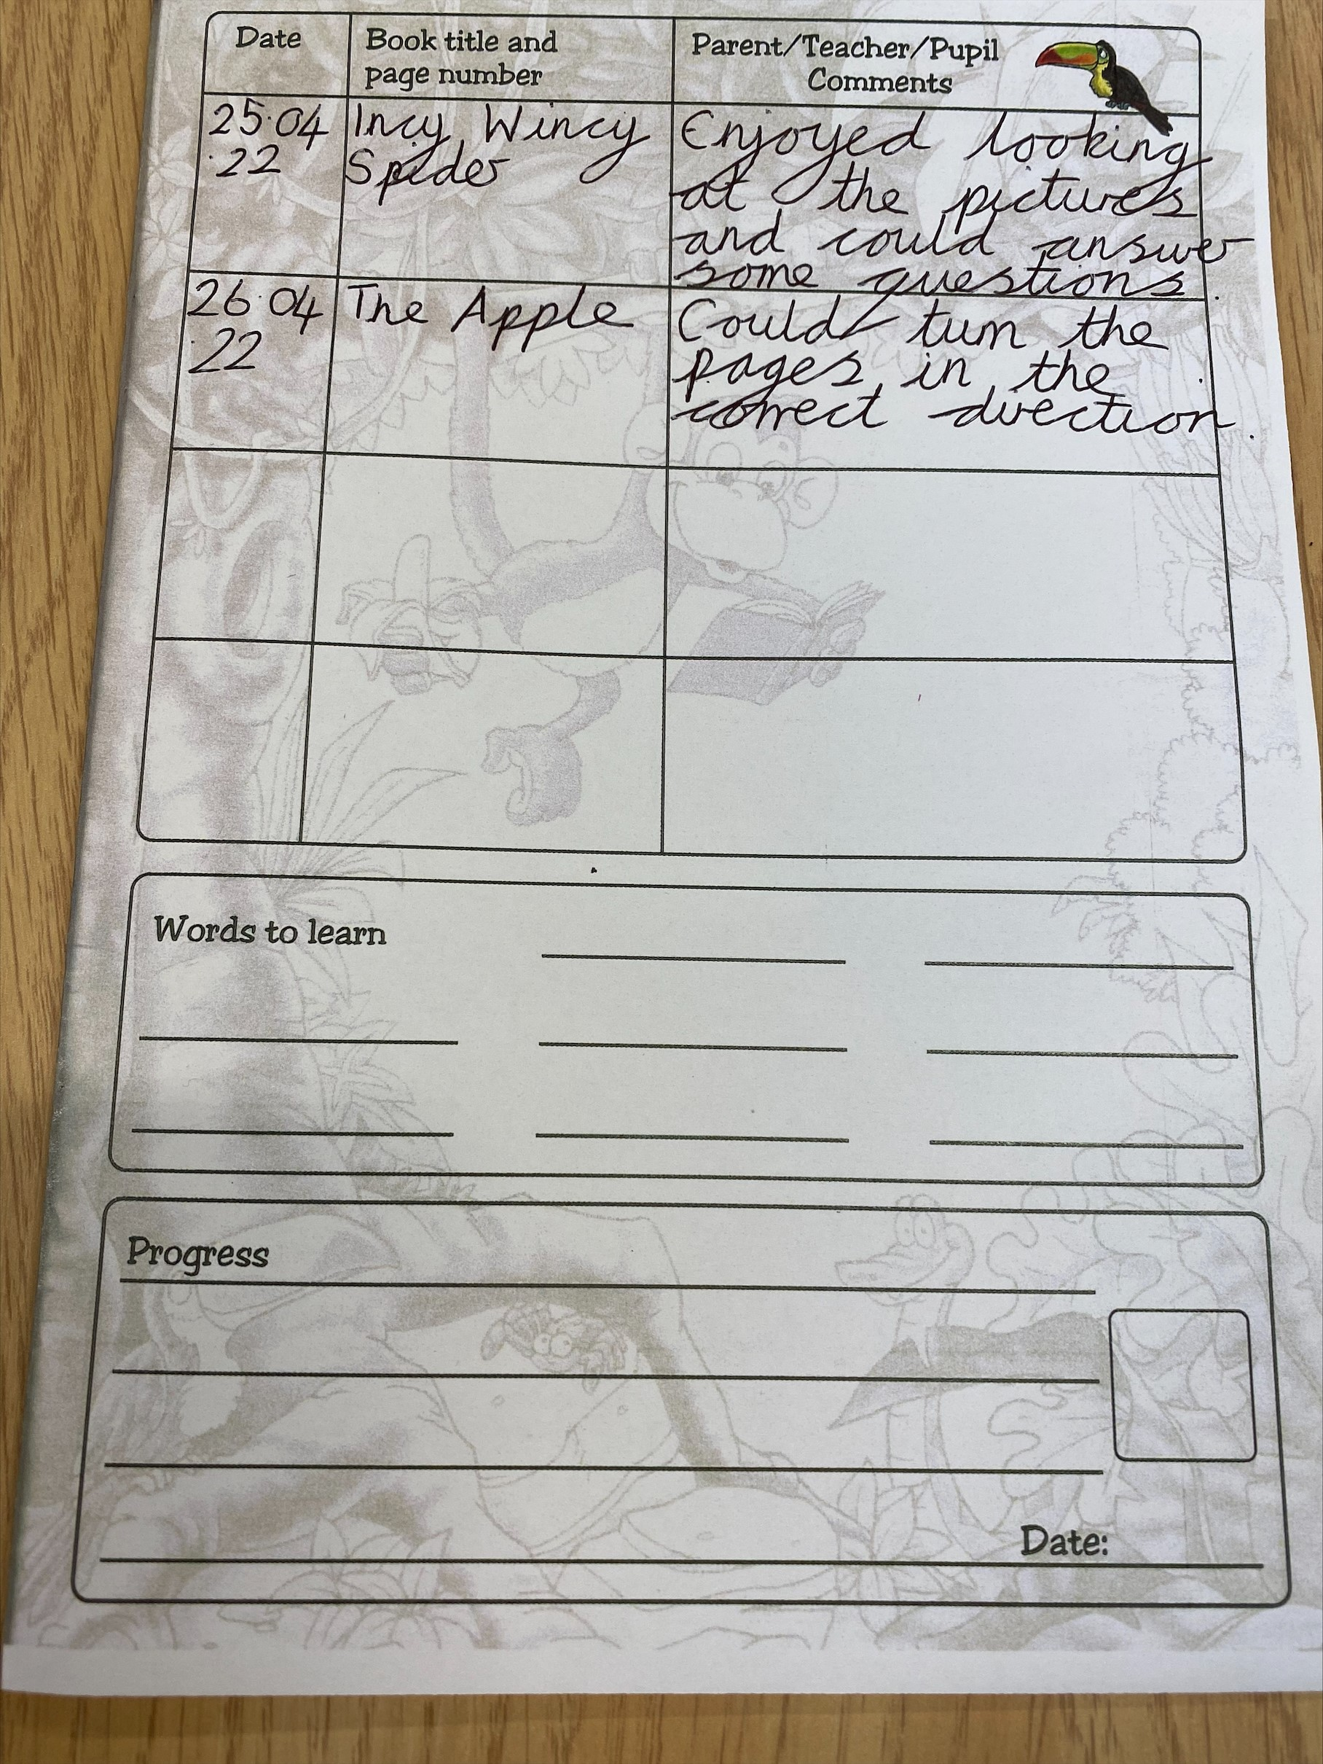
Recording in a reading diary

Slide 23
Home Learning
For each aspect of phonics that your child has learnt at school, a home learning challenge sheet will be sent home. These include ideas of activities that you can do easily at home to support your child in this aspect.
A parent guide is also sent home when each aspect of phase 1 is being taught to give you some more information. If you have any questions about these, then please ask a member of staff in the room.
When you complete a home learning challenge with your child, please could you record this on Tapestry?

Slide 24
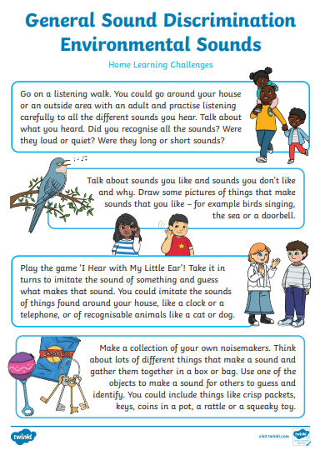
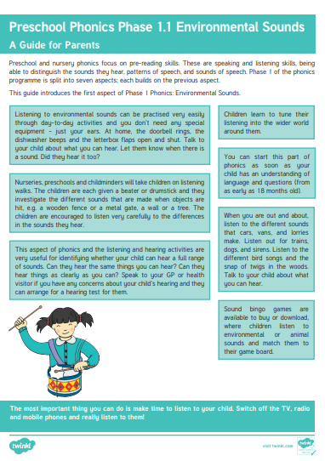
Home Learning – Example sheets

Slide 25
Useful Websites
www.phonicsplay.co.uk
https://www.bbc.co.uk/cbeebies/shows/alphablocks
www.letterjoin.co.uk
https://letters-and-sounds.com

Slide 26
Questions

